Slide 1


Citi Postsecondary Success Program:
2013 Data Snapshot for Miami
Presented to the Citi Foundation
Spring 2013
Notes:
1

Slide 2
Introduction
About CPSP
The Citi Postsecondary Success Program (CPSP) is a five-year initiative (2009-2013) to increase access to and success in college among underrepresented students in Miami-Dade, San Francisco, and Philadelphia. CPSP supports local education funds (LEFs) in leveraging programs and institutional policies to create a continuum of supports for students. The LEFs work in partnership with the school system, higher education institutions, CBOs, the business community, and other sectors to promote systems change. CPSP’s core work in each site is establishing successful pilot programs to provide examples of school-wide college access and success (CAS) supports for district-wide adaptation. Data collection, analysis, and dissemination play a critical role in CPSP. Tracking college-related milestones—including FAFSA completion, academic achievement, course enrollment, and college application, enrollment, and persistence—helps inform partner strategy and make the case for shifts in practice and institutional policies at the district level.
About the Evaluation
About the Evaluation
OMG is conducting a summative and formative evaluation of CPSP, using quantitative and qualitative methods, to answer the following question: “How did CPSP impact college enrollment and second-year retention of students in the Target schools?” To answer this, OMG follows the progress of students in the classes of 2012 and 2013, including achievement of CAS milestones, academic progress, graduation, and enrollment and persistence in college. OMG compares the results of Target-school students to those of students in schools with similar characteristics (including demographics and academic achievement). Because we cannot control for a number of factors, we will not be able to say whether differences in the two groups are attributable to CPSP, but the analysis will be suggestive of the effect of CPSP on Target students. A Comparison of the two groups, as well as to district-wide averages, also provides context in assessing CPSP.
About this Snapshot
This data snapshot provides four-year trends on high school graduation, and college enrollment from 2009-2012 in the District, Target, and Comparison schools. We also include three-year trends for one-year college persistence for the classes of 2009, 2010 and 2011. Appendix 1 provides important definitions, Appendix 2 provides some notes on the methodology used for this analysis, and Appendix 3 provides notes on the different data pulls and related documentation.
2
Notes:
2
2

Slide 3
School Key
Note to LEF:
To maintain confidentiality, consider removing this slide before sharing with external partners
CPSP Target Schools:
Target 1 – Southridge
Target 2 – Miami Beach
Target 3 – Westland Hialeah
CPSP Comparison Schools:
Homestead
Miami
Hialeah
3
Notes:
3
3

Slide 4
Key Findings: Graduation and Enrollment
High School Graduation Four Year Trends: 2009 to 2012*
12th grade high school graduation trends were similar for the district overall, target schools, and comparison schools. For all groups of schools, graduation rates increased from 2009-2011; the increase in those years was largest among target schools. Rates declined in 2012, likely a result of stricter graduation requirements that went into effect in the 2011-12 school year. Between 2009 and 2012, 12th grade high school graduation rates among CPSP target schools went up by 12% (from 78% to 87%); started and ended for the overall district around 85%; and increased for comparison schools by 10% (from 83% to 91%). (Fig. 1, p. 7)
12th grade graduation rates among individual target schools varied over the four years: two schools saw an overall decline, while one saw a 14% increase. Target school 1 experienced a 14% increase in graduation rates between 2009 and 2012 (from 70% to 80%), after experiencing a peak at 98% in 2011. Target school 2 saw a 3% decrease, from 93% in 2009 to 90% in 2012, with a peak in 2011 of 96%. Target school 3 experienced a 9% decline from 98% in 2010 to 90% in 2012. (Fig. 4, p. 8)
College Enrollment Four Year Trends: 2009 to 2012*
Target schools on average increased college enrollment rates by 34% over the four years. Average college enrollment among CPSP target schools increased from 35% in 2009 to 47% in 2012. College enrollment remained fairly steady over this period both for district schools (from 51% in 2009 to 53% in 2012, with a peak at 56% in 2011) and comparison schools (44% in 2009 to 45% in 2012, with a peak at 47% in 2011). (Fig. 2, p. 7)
Target schools narrowed their college enrollment gap with the district overall by over two-thirds during the course of CPSP. While, in 2009, college enrollment among target schools was 46% lower than the district’s (35% versus 51%), the difference had narrowed to just 13% by 2012 (47% versus 53%). 2012, CPSP target schools (on average) trailed the district in college enrollment by 13% (47% enrollment among target schools versus 53% among district schools overall). Comparison schools’ gap with the district increased between 2009 and 2012, from 13% to 18%. (Fig. 2, p. 7)
College enrollment rates among individual target schools increased over the four years, although rates at two schools peaked in 2011 and then declined in 2012. CPSP target school 1 saw a 20% increase in college enrollment rates between 2009 and 2012 (30% to 36%). Similarly, target school 3 experienced an 11% increase in college enrollment (from 46% in 2010 to 51% in 2012). Both target school 1 and 3 experienced a drop off in enrollment rates between 2011 and 2012. College enrollment rates in target school 2 increased each of the four years, rising by 23% over the course of the initiative (from 43% in 2009 to 53% in 2012). (Fig. 5, p. 8)
*Note: as a new school, target school 3 has only three years of enrollment data: 2010 to 2012)
About the Evaluation
4
Notes:
4
4

Slide 5
Key Findings: Enrollment by Demographics
College Enrollment Four Year Trends: 2009 to 2012, by Demographics*
Among CPSP target schools, black student enrollment increased by 69% over the course of the initiative. Black students’ college enrollment rose strongly—by 69%—among CPSP target schools over the four years of analysis (26% in 2009 to 44% in 2012). Whereas in 2009, black students’ college enrollment rates among CPSP target schools were much lower than those of the district and comparison schools, by 2012 they had matched the district’s and comparison school’s enrollment rates (42% district, 44% comparison, 44% target schools).The gains in black students’ college enrollment were greatest in target school 1 (24% to 44%, an 83% increase); target school 2 experienced small gains (40% to 44%, a 10% increase); changes in target school 3 are not available due to the small sample size. (Tables 2-5, p. 10)
College enrollment among Latino students in the CPSP target schools increased by 25%, from 36% to 45% between 2009 and 2012. District schools remained fairly stable, from 52% to 55%, with a peak of 59% in 2011. Comparison schools’ improvement was similar to the overall district, rising modestly from 43% in 2009 to 45% in 2012. While college enrollment rates for Latino students in target school 1 increased over the first three years, they fell off in 2012 (rising from 30% in 2009 to 38% in 2011 before declining to 28% in 2012); Latino enrollment rates in target schools 2 and 3 increased by 11% and 13% respectively (from 44% to 49% for target school 2 and from 45% in 2010 to 51% for target school 3). (Tables 2-5, p. 10)
College enrollment rates among ELL students in the CPSP target schools increased by 23%, whereas rates in comparison schools and the district remained fairly stable. In 2009, ELL student enrollment in target schools was 35%, increasing to 43% by 2012. This is in contrast to the steady state in comparison schools (from 44% to 45%), and a 6% improvement in district schools overall (from 49% to 52%). Trends in ELL students’ college enrollment varied across the three CPSP target schools. ELL enrollment in target school 1 peaked in 2011, and then declined in 2012 for an average decline of 10% over the four years (30% in 2009, 41% in 2011, 27% in 2012). In target schools 2 and 3, by contrast, ELL enrollment grew steadily: by 18% in target school 2 (from 40% in 2009 to 47% in 2012) and by 17% in target school 3 (from 42% in 2010 to 49% in 2012). (Tables 2-5, p. 10)
*Note: as a new school, target school 3 has only three years of enrollment data: 2010 to 2012)
About the Evaluation
5
Notes:
5
5

Slide 6
Key Findings: Persistence
College Persistence Three Year Trends: 2009 to 2011*
Target school one-year college persistence rates increased by 30% over three years, while the district’s rate remained steady and comparison schools saw a slight decrease. One-year college persistence increased between 2009 and 2011 among CPSP target schools from 27% to 38%; improved slightly among District schools (44% to 46%); and declined by 8% among comparison schools (38% to 35%). All three CPSP target schools had growth in one-year college persistence. Target school 1 increased by 35% (from 23% in 2010 to 31% in 2011), target school 2 increased by 14% (from in 2009 36% to 41% in 2011), and target school 3 increased by 20% (from 35% in 2010 to 42% in 2011). (Fig. 3, p. 7 and Fig. 6 p. 8)
College Persistence Three Year Trends: 2009 to 2011, by Demographics*
Black students’ college persistence increased by 60% among CPSP target schools. On average, black student one-year persistence increased by 60% among CPSP target schools between 2009 and 2011 (from 20% to 32%). In contrast, persistence rates for the district remained stable (36% to 36%) and decreased by 32% for comparison schools (41% to 28%). (Tables 6-8, p. 11)
Latino students’ college persistence showed a 28% improvement among CPSP target schools. Between 2009 and 2011, one-year persistence among Latino students went from 29% to 37%, a 28% improvement. This was driven largely by the strong increases in target school 1 (22% to 30%, a 36% improvement). Among district schools, college persistence among Latino students increased slightly (45% to 49%) during the same period, while it decreased slightly among comparison schools (38% to 36%,). (Tables 6-8, p. 11)
ELL students’ college persistence increased 29% among CPSP target schools. Between 2009 and 2011 ELL students’ one-year college persistence went from 28% to 36% among target schools; target schools 1 and 3 saw strong improvements of 26% and 23%, respectively (23% in 2009 to 29% in 2011 for target school 1, and 35% in 2010 to 43% in 2011 for target school 3);target school 2 remained steady (32% to 33%). Among district schools, persistence trends were fairly stable for ELL students (from 43% to 45%), and decreased by 10% among comparison schools (from 39% to 35%).(Tables 6-8, p. 11)
*Note: as a new school, target school 3 has only two years of persistence data: 2011 to 2012)
About the Evaluation
6
Notes:
6
6

Slide 7
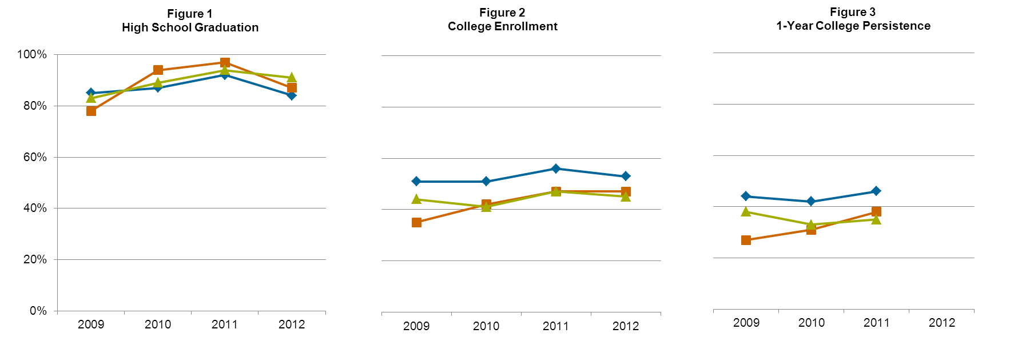
Graduation, Enrollment, and Persistence Trends: Averages
Average Trends in District, Target, and Comparison Schools*
District
Target
Comp
High School Graduation |  |  |  |  |  | College Enrollment |  |  |  |  |  | 1-yr College Persistence
 | 2009 | 2010 | 2011 | 2012 |  |  | 2009 | 2010 | 2011 | 2012 |  |  | 2009 | 2010 | 2011 | 2012
District | 85% | 87% | 92% | 84% |  | District | 51% | 51% | 56% | 53% |  | District | 44% | 42% | 46% | -
Target | 78% | 94% | 97% | 87% |  | Target | 35% | 42% | 47% | 47% |  | Target | 27% | 31% | 38% | -
Comp | 83% | 89% | 94% | 91% |  | Comp | 44% | 41% | 47% | 45% |  | Comp | 38% | 33% | 35% | -
*Out of students entering 12th grade;
See Appendix 2 for Ns
Question for Further Reflection:
What can be learned from the strong improvements in college enrollment and persistence among CPSP target schools that could benefit all schools in Miami-Dade County?
7
Notes:
7
7

Slide 8
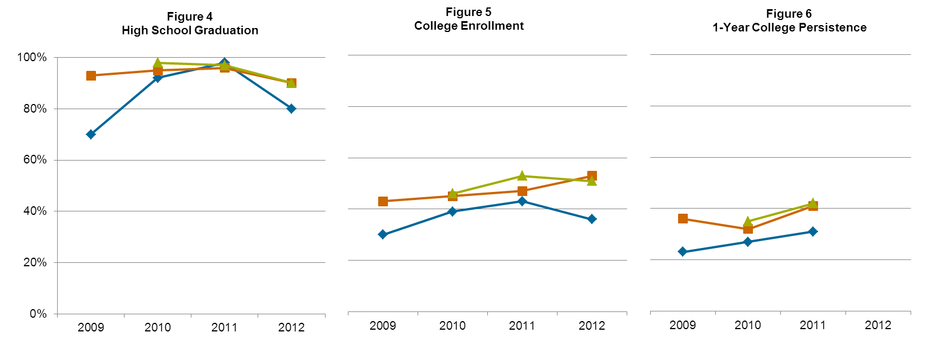
Graduation, Enrollment, and Persistence Trends: by Target Schools
Trends in CPSP Target Schools*
*Out of students entering 12th grade;
See Appendix 2 for Ns
Target 1
Target 2
Target 3
High School Graduation |  |  |  |  |  | College Enrollment |  |  |  |  |  | College Persistence
 | 2009 | 2010 | 2011 | 2012 |  |  | 2009 | 2010 | 2011 | 2012 |  |  | 2009 | 2010 | 2011 | 2012
Target 1 | 70% | 92% | 98% | 80% |  | Target 1 | 30% | 39% | 43% | 36% |  | Target 1 | 23% | 27% | 31% | -
Target 2 | 93% | 95% | 96% | 90% |  | Target 2 | 43% | 45% | 47% | 53% |  | Target 2 | 36% | 32% | 41% | -
Target 3 |  | 98% | 97% | 90% |  | Target 3 |  | 46% | 53% | 51% |  | Target 3 |  | 35% | 42% | -
Question for Further Reflection:
What contextual or institutional factors might explain the varying trends across the three target schools in college enrollment and persistence?
8
Notes:
8
8

Slide 9
Class of 2012 Overall Demographics
Table 1: Class of 2012 Demographics
 | District | Target | Comp | Target 1 | Target 2 | Target 3
Black | 25% (n=4707) | 16 (207) | 12 (163) | 36 (151) | 8 (41) | 4 (15)
Latino | 65% (n=11967) | 71 (928) | 85 (1143) | 55 (231) | 66 (322) | 94 (375)
White | 8% (n=1547) | 12 (157) | 2 (31) | 7 (30) | 24 (118) | *
Asian | 1% (n=221) | 1 (15) | * | * | * | *
ELL | 57% (n=10507) | 60 (786) | 75 (1007) | 43 (182) | 55 (270) | 84 (334)
9
Notes:
9
9

Slide 10
College Enrollment by Demographics
Table 2: Class of 2009 College Enrollment, by Demographics
 | District | Target | Comp | Target 1 | Target 2 | Target 3
Black | 43% | 26 | 47 | 24 | 40 | n/a
Latino | 52% | 36 | 43 | 30 | 44 | n/a
White | 65% | 53 | 45 | 58 | 49 | n/a
Asian | 70% | * | * | * | * | n/a
ELL | 49% | 35 | 44 | 30 | 40 | n/a
Table 3: Class of 2010 College Enrollment, by Demographics
 | District | Target | Comp | Target 1 | Target 2 | Target 3
Black | 44% | 41 | 41 | 40 | 44 | *
Latino | 53% | 43 | 42 | 40 | 43 | 45
White | 62% | 47 | 31 | 26 | 54 | *
Asian | 62% | 47 | 58 | * | * | *
ELL | 50% | 41 | 40 | 37 | 43 | 42
Table 4: Class of 2011 College Enrollment, by Demographics
 | District | Target | Comp | Target 1 | Target 2 | Target 3
Black | 47% | 42 | 41 | 40 | 44 | *
Latino | 59% | 47 | 47 | 43 | 44 | 53
White | 65% | 54 | 45 | 38 | 67 | *
Asian | 71% | 71 | 77 | 91 | 50 | *
ELL | 55% | 45 | 46 | 41 | 39 | 54
Table 5: Class of 2012 College Enrollment, by Demographics
 | District | Target | Comp | Target 1 | Target 2 | Target 3
Black | 42% | 44 | 44 | 44 | 44 | *
Latino | 55% | 45 | 45 | 28 | 49 | 51
White | 64% | 62 | 52 | 47 | 66 | *
Asian | 72% | * | * | * | * | *
ELL | 52% | 43 | 45 | 27 | 47 | 49
Question for Further Reflection:
What can be learned from the success of the CPSP target schools about how to best support black, Latino, and ELL students in preparing for and enrolling in college?
10
Notes:
10
10

Slide 11
College Persistence by Demographics
Table 6: Class of 2009 College Persistence, by Demographics
 | District | Target | Comp | Target 1 | Target 2 | Target 3
Black | 36% | 20 | 41 | 18 | 33 | n/a
Latino | 45% | 29 | 38 | 22 | 37 | n/a
White | 56% | 43 | 35 | 49 | 37 | n/a
Asian | 64% | * | * | * | * | n/a
ELL | 43% | 28 | 39 | 23 | 32 | n/a
Table 7: Class of 2010 College Persistence, by Demographics
 | District | Target | Comp | Target 1 | Target 2 | Target 3
Black | 34% | 27 | 29 | 26 | 31 | *
Latino | 44% | 32 | 34 | 29 | 30 | 36
White | 55% | 37 | 13 | 16 | 45 | *
Asian | 59% | 35 | 42 | * | * | *
ELL | 41% | 31 | 33 | 28 | 29 | 35
Table 8: Class of 2011 College Persistence, by Demographics
 | District | Target | Comp | Target 1 | Target 2 | Target 3
Black | 36% | 32 | 28 | 28 | 40 | *
Latino | 49% | 37 | 36 | 30 | 39 | 42
White | 56% | 45 | 32 | 34 | 56 | *
Asian | 66% | 58 | * | * | * | *
ELL | 45% | 36 | 35 | 29 | 33 | 43
Question for Further Reflection:
What can be learned from the success of the CPSP target schools about how to best prepare black, Latino, and ELL students for success in college?
11
Notes:
11
11

Slide 12
Pipeline Analysis: Target School Averages by Year
Enrolled in 12th Grade
Graduated
High School
Enrolled in
College
Persisted
1 Year
Target Average
Class of 2009
100%
78%
35%
27%
N=295
N=227
N=842
N=657
Target Average
Class of 2010
100%
94%
42%
31%
N=433
N=312
N=1,031
N=969
Target Average
Class of 2011
100%
97%
47%
38%
N=549
N=442
N=1,168
N=1,133
Target Average
Class of 2012
100%
87%
47%
?
N= 615
N=1,313
N= 1143
12
Notes:
12
12

Slide 13
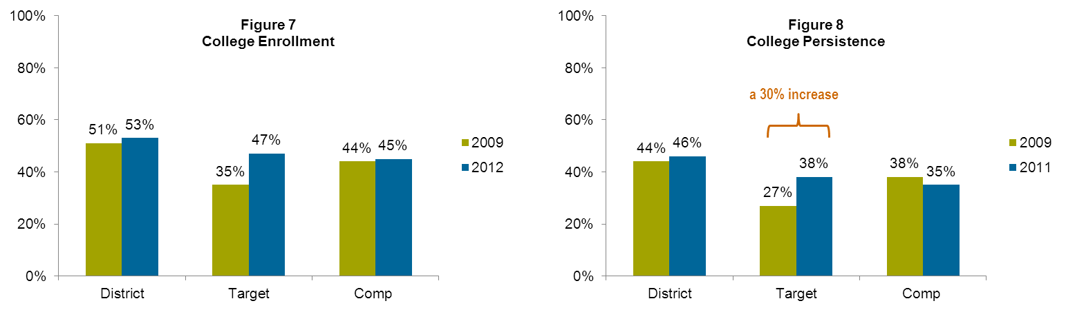
Summary: CPSP in Miami-Dade - A Success Story for Students
Average in District, Target, and Comparison Schools
a 34% increase
13
Notes:
13
13

Slide 14
Appendix 1: CPSP Terminology
College Access and Success Milestones – accomplishments that indicate that students are on the path to accessing postsecondary education (e.g., completed FAFSA, submitted college applications, accepted to college).
College Enrollment – we consider a student to be enrolled in college when that student enrolls in college the fall semester following high school graduation.
College Persistence – we define persistence as when a student enrolls in college for the second consecutive year.
Comparison Schools – are schools included in the evaluation because they are similar to Target Schools in terms of known characteristics of the school and student body, including race/ethnicity, free/reduced price lunch eligibility, percent Limited English Proficient, Title I eligibility, and academic achievement.
Delayed College Enrollment - we consider a student to have delayed college enrollment when they postponed enrollment until the second fall after graduation.
District Data - are data collected by OMG directly from the school districts in the three CPSP sites. District Data include: student demographics, GPA, credit accumulation, standardized assessment scores, and high school graduation status.
High School Graduation – for the purpose of the evaluation, we define high school graduation as occurring immediately upon the completion of a student’s senior year.
National Student Clearinghouse (NSC) Data - are data on college enrollment and persistence collected by the NSC, a non-profit organization that maintains information about college-going activity. The NSC will provide the data to the school districts, and the school districts, in turn, will provide the data (de-identified) to OMG.
Qualitative Data - include information that is difficult to measure, count, or express in numerical terms.
Target Schools – are the schools selected by the LEFs to implement CPSP in each city.
14
Notes:
14
14

Slide 15
Appendix 2: Methodology
All data were provided to OMG from Miami Dade County Public Schools, Office of Assessment, Research, and Data Analysis, and analyzed using SAS for Windows, v. 9.3.
Special Education students were excluded from all analyses.
First fall (immediate) college enrollment was defined as having enrolled in an institution of higher education on or before October 1 in the year of high school graduation.
Second year persistence was defined as having enrolled in the first fall and having enrolled on or before October 1 in the year following high school graduation.
Percentages in charts and tables were rounded and therefore may not add up to 100%.
Ns of 10 or less in the demographic tables were not reported in order to protect students’ identities.
All proportions and averages are weighted according to the number of students in each subgroup.
All percentages are calculated out of the total number of students entering 12th grade in a given year. Target School 3—a new school--did not have a graduating class in 2009; it is excluded from the 2009 analysis, along with its comparison school. See below for Ns used throughout:
Number of Students Entering 12th Grade
 | District | Target | Comp | Target 1 | Target 2 | Target 3
2009 | 17,748 | 842 | 920 | 543 | 299 | n/a
2010 | 17,790 | 1,031 | 1,617 | 446 | 353 | 232
2011 | 18,073 | 1,168 | 1,500 | 425 | 424 | 319
2012 | 18,511 | 1,313 | 1,342 | 423 | 490 | 400
15
Notes:
15
15

Slide 16
Appendix 3: Data Pulls and Documentation
16
Notes:
16
16

